Slide 1
CSE 430: Software Quality Assurance and Testing
Anika Tabassum
Lecturer
CSE. EWU

Slide 2
Lecture 05
Software Testing Terminology and Methodology

Slide 3
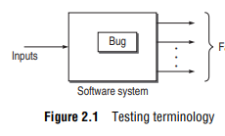
Definitions
Failure: when results or behaviour of the system under test are different as compared to specified expectations, then failure exists.
Fault/Defect/Bug: Fault is a condition that in actual causes a system to produce failure. One failure may be due to one or more bugs and one bug may cause one or more failures.

Slide 4

Definitions
Error: Whenever a development team member makes a mistake in any phase of SDLC, errors are produced.

Slide 5
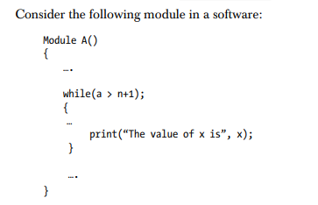
An Example
Failure: When this module will be executed, the value of x will not be printed
Bug/defect/fault: A condition is preventing the body of while loop to be executed.
Error: a semicolon being misplaced after the while loop which is not its correct syntax and it is not allowing the loop to execute

Slide 6
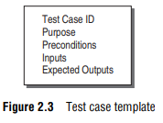
Test Case Template

Slide 7
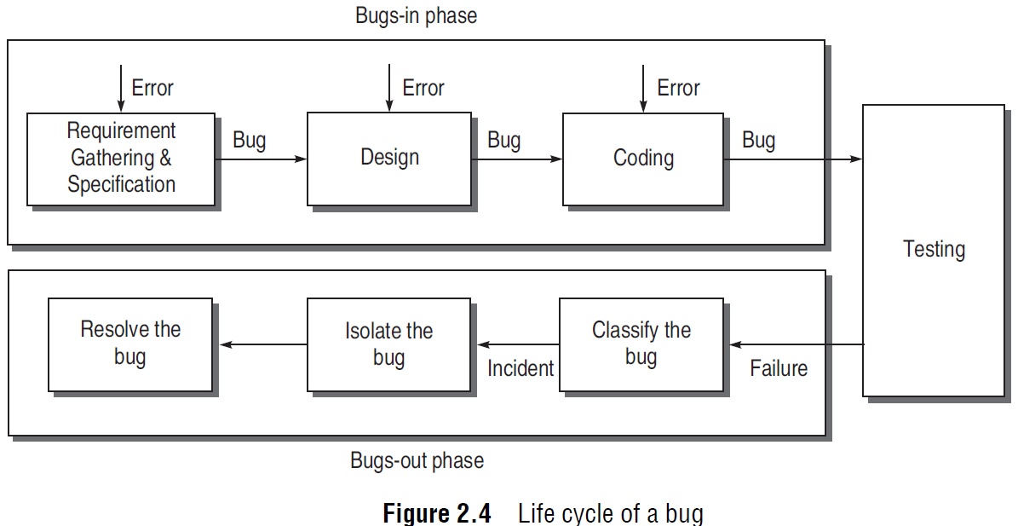
Life Cycle of a Bug

Slide 8
LIFE CYCLE OF A BUG
Bugs-In Phase
Bugs-Out Phase
This phase is where the errors and bugs are introduced in the software. Thus, a phase may have its own errors as well as bugs received from the previous phase.
In this phase, when we observe failures, the following activities are performed to get rid of the bugs.
Bug classification: we observe the failure and classify the bugs according to its nature.
Bug isolation: Bug isolation is the activity by which we locate the module in which the bug appears.
Bug resolution: Once we have isolated the bug, we back-trace the design to pinpoint the location of the error.

Slide 9
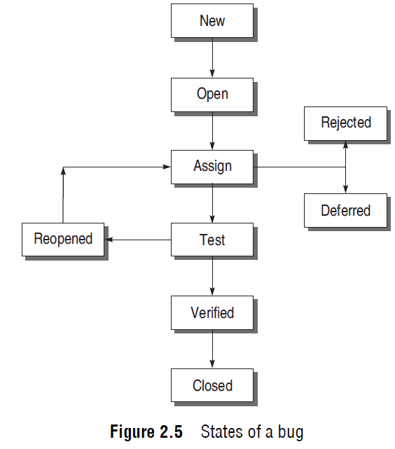
States Of A Bug

Slide 10
States Of A Bug
New: The state is new when the bug is reported first time by a tester.
Open: When the test leader approves that the bug is genuine, its state becomes open.
Assign: An open bug comes to the development team where the development team verifies its validity. If the bug is valid, a developer is assigned the job to fi x it and the state of the bug now is ‘ASSIGN’.

Slide 11
States Of A Bug
Deferred: If the priority of the reported bug is not high or there is not sufficient time to test it or the bug does not have any adverse effect on the software, then the bug is changed to deferred state which implies the bug is expected to be fixed in next releases.
Rejected: It may be possible that the developer rejects the bug after checking its validity, as it is not a genuine one.

Slide 12
States Of A Bug
Test: Before releasing to the testing team, the developer changes the bug’s state to ‘TEST’.
Verified/fixed: After verifying, the developer approves that the bug is fixed and changes the status to ‘VERIFIED’.
Reopened: If the bug is still there even after fixing it, the tester changes its status to ‘REOPENED’.
Closed: Once the tester and other team members are confirmed that the bug is completely eliminated, they change its status to ‘CLOSED’.

Slide 13
Bug Classification
Based on criticality there are four broad categories.
Critical Bugs: stops or hangs the normal functioning of the software.
Major Bugs: causes a functionality to fail to meet its requirements as expected
Medium Bugs: outputs are not according to the standards or conventions, e.g. redundant or truncated output
Minor Bugs: do not affect the functionality of the software, e.g., typographical error or misaligned printout

Slide 14
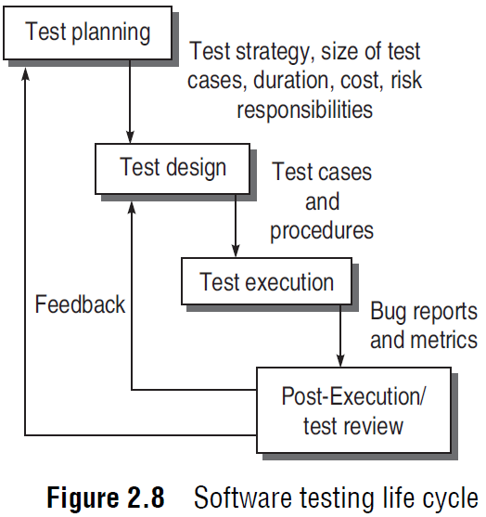
Software Testing Life Cycle (STLC)

Slide 15
Test Planning
The goal of test planning is to take into account the important issues of testing strategy, viz. resources, schedules, responsibilities, risks, and priorities, as a roadmap.
Defining the test strategy. 
Estimate the number of test cases, their duration, and cost. 
Plan the resources like the manpower to test, tools required, documents required. 

Slide 16
Test Planning
Identifying areas of risks. 
Defining the test completion criteria metrics.
Identification of methodologies, techniques, and tools for various test cases. 
Identifying reporting procedures, bug classification, databases for testing, bug severity levels, and project

Slide 17
Test Design
Determining the test objectives and their prioritization
Preparing list of items to be tested
Mapping items to test cases
Selection of test case design techniques
Creating test cases and test data
Setting up the test environment and supporting tools
Creating test procedure specification

Slide 18
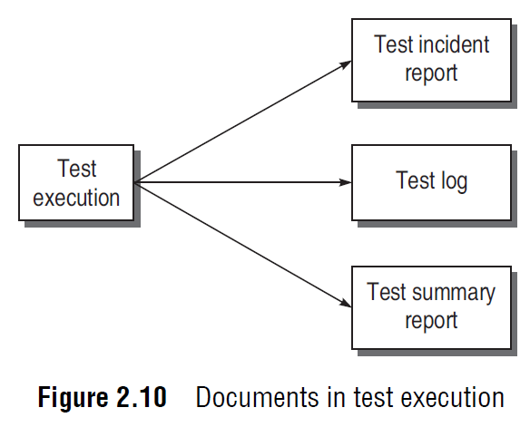
Test Execution

Slide 19
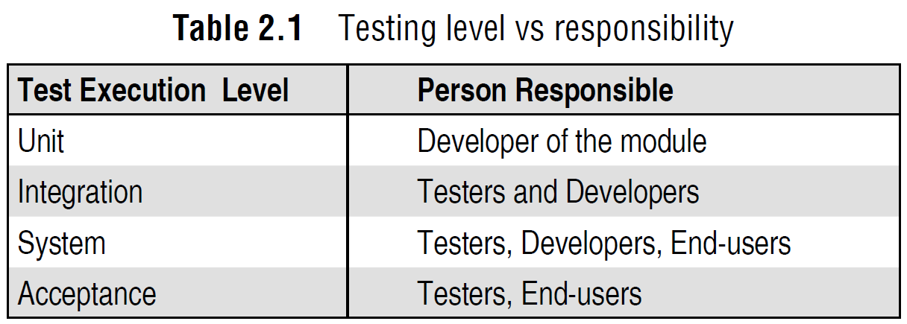
Testing Responsibility

Slide 20
Post-Execution/Test Review
Understanding the bug
Reproducing the bug
Analysing the nature and cause of the bug

Slide 21
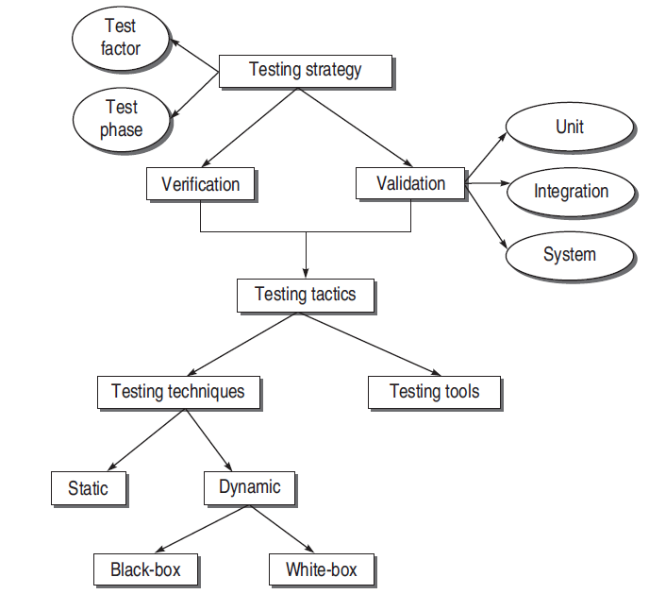
Testing Methodology

Slide 22
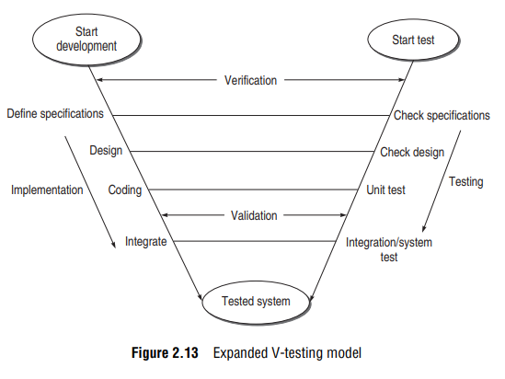
V-Testing Life Cycle Model

